Slide 1
Currency-Exchange Portal
By
Group-3

Slide 2
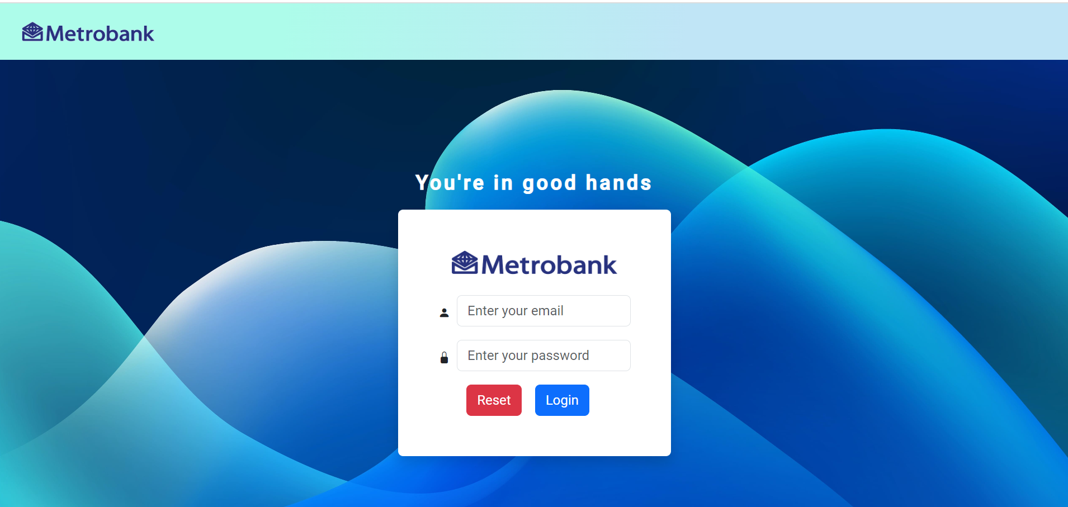
Login Page

Slide 3
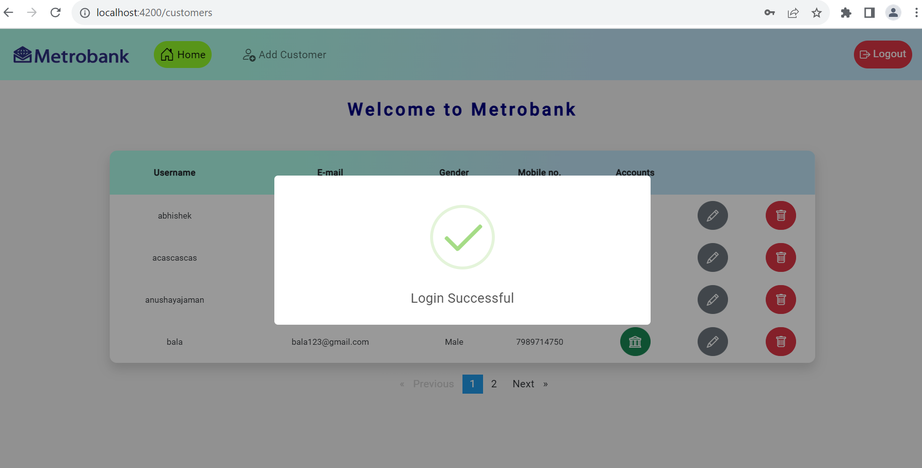
Login Successful message

Slide 4
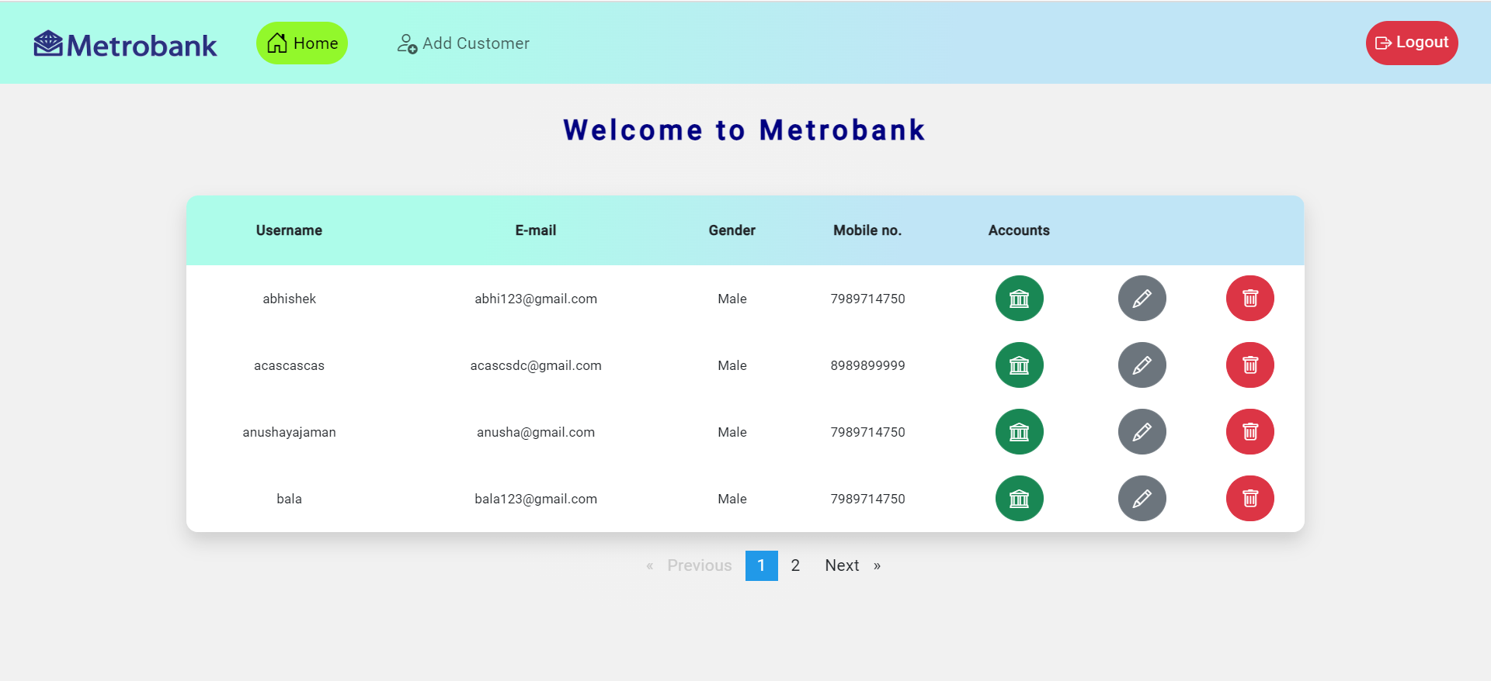
Admin-Dashboard

Slide 5
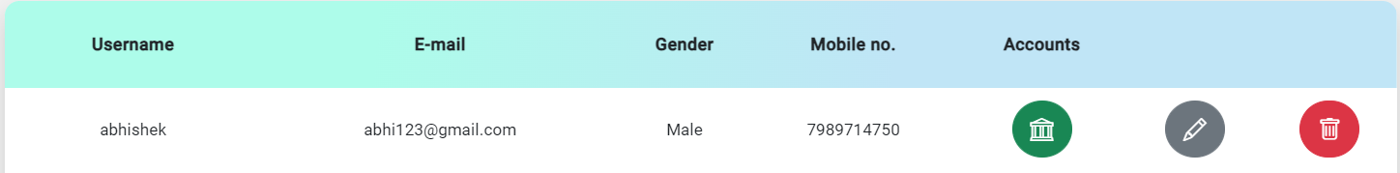
Admin Actions for customer
Open Accounts
Delete customer
Edit customer

Slide 6
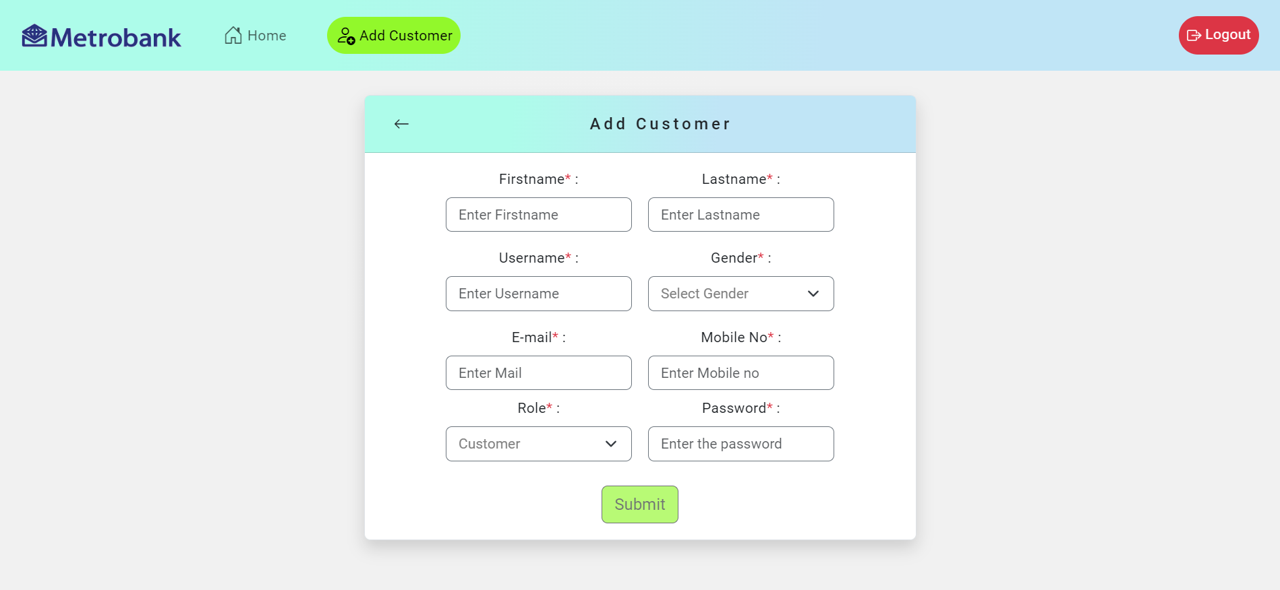
Add-Customer Page with validations

Slide 7
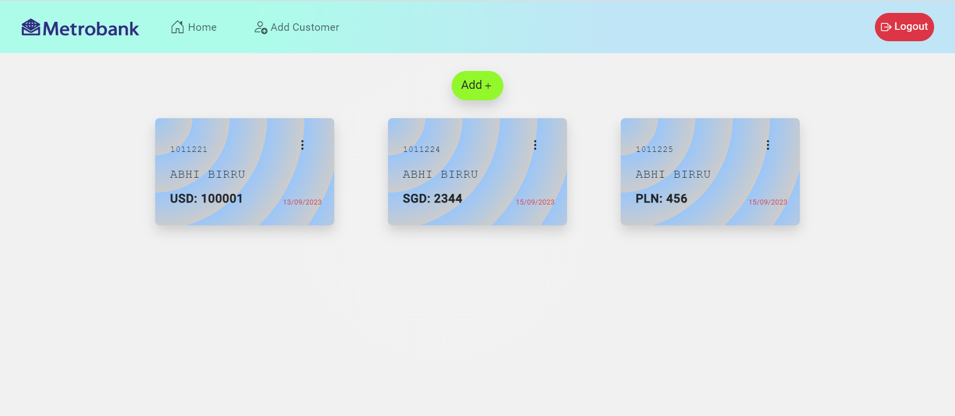
Customer-Accounts Page

Slide 8
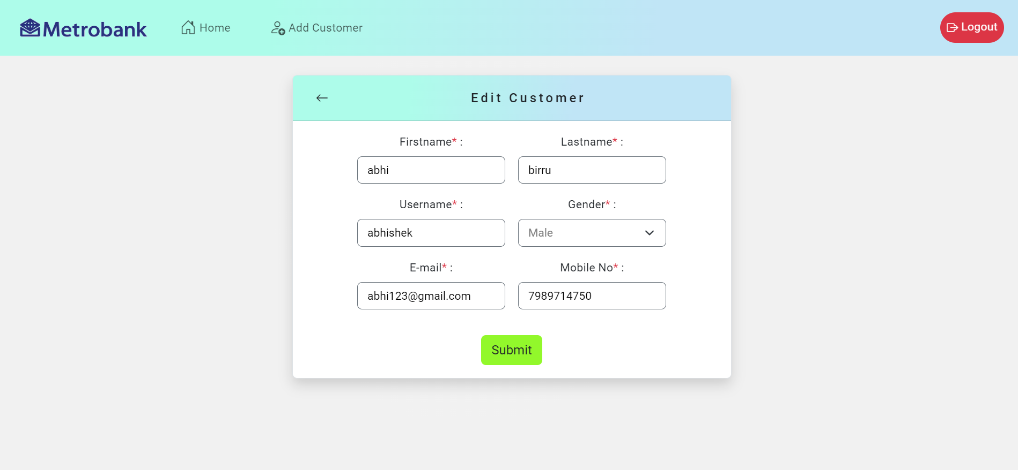
Edit-Customer Page

Slide 9
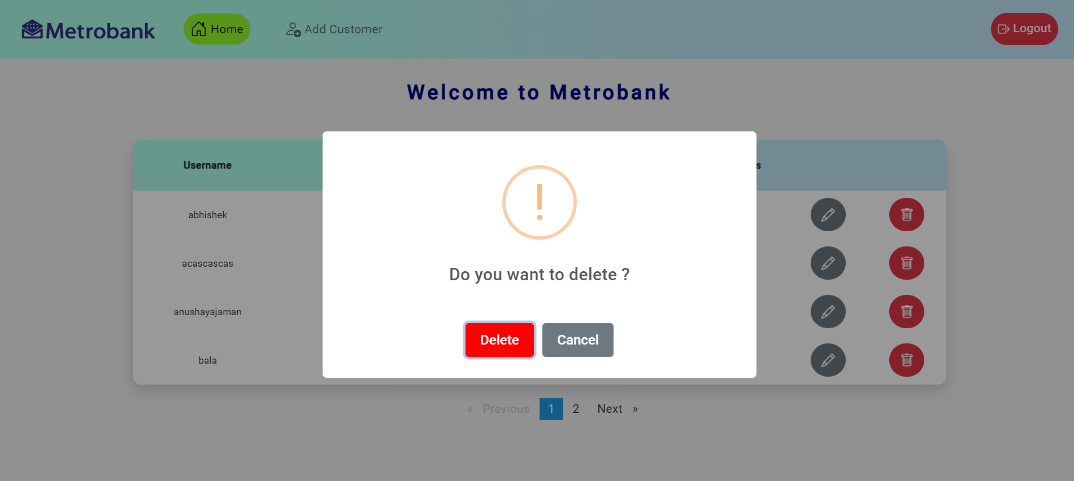
Delete-Customer

Slide 10
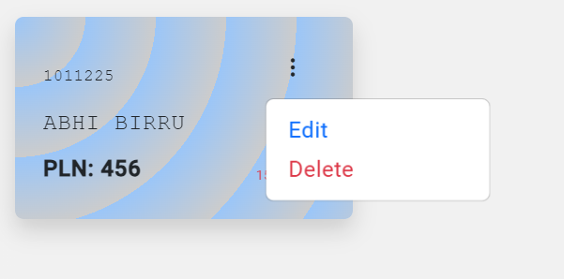
Account-Actions for admin

Slide 11
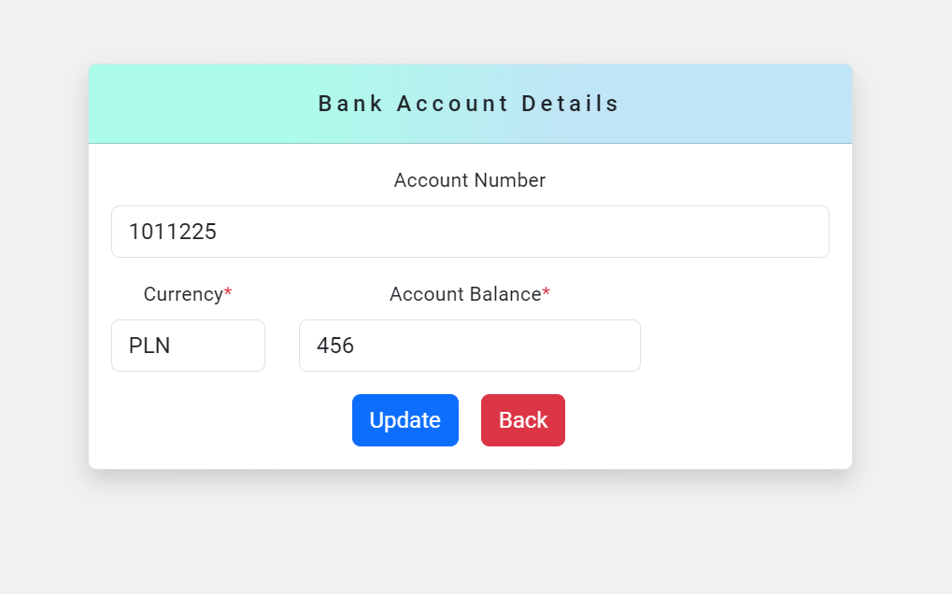
Edit-Account

Slide 12
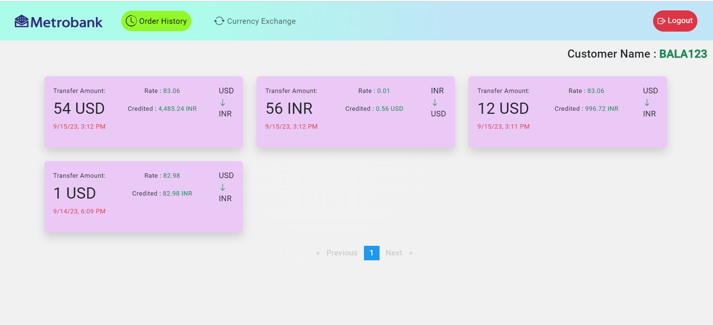
Customer-Transactions page

Slide 13
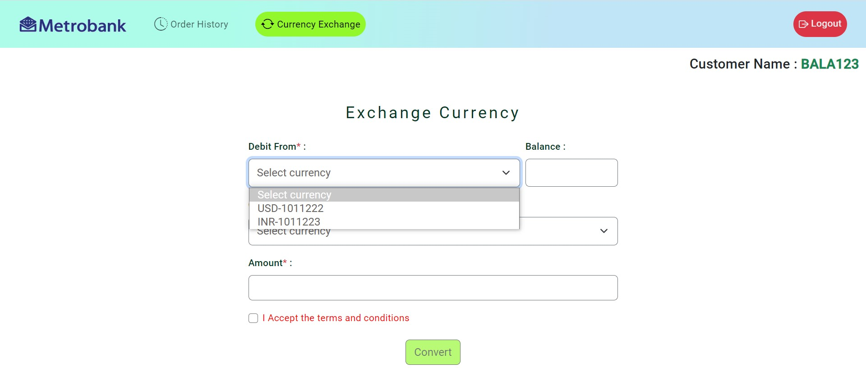
Currency-Exchange Page

Slide 14
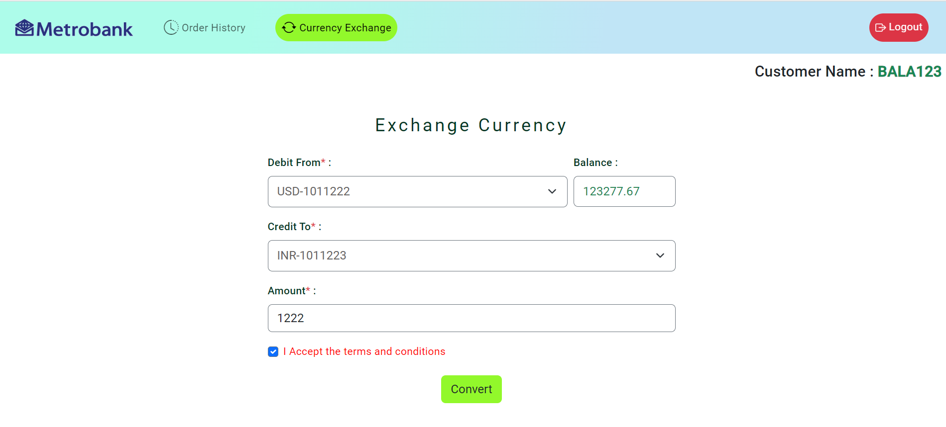

Slide 15
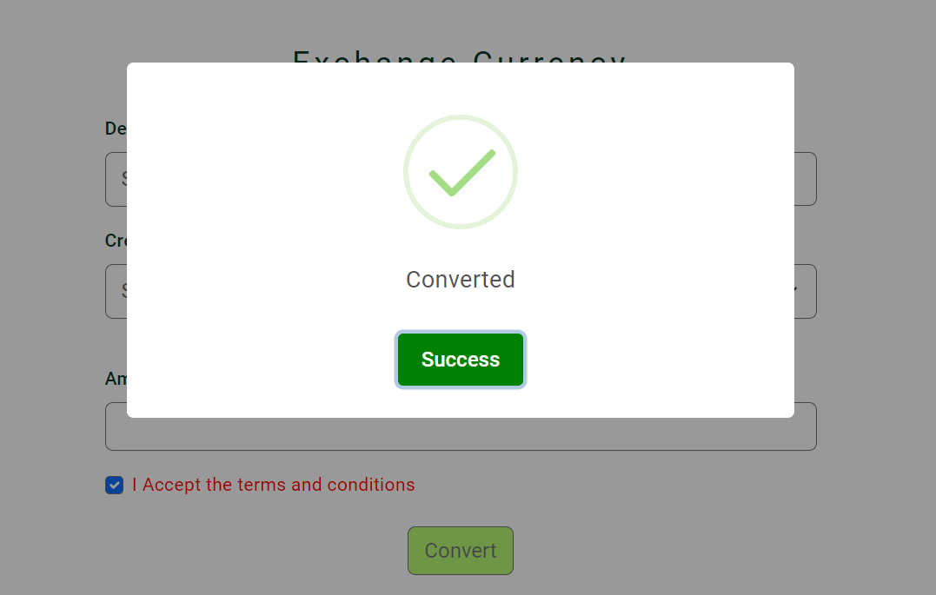
Success message after conversion

